Slide 1
Hydrostatic Pick-Up
By Jake and Garret

Slide 2
Objective
Our mission on this project was to create a 1 ton Hydrostatic service truck with the capabilities of powering its own tools utilizing the onboard hydraulics.
  Examples
    Winch
    Crane
    Generator
    Tilt bed
    Log slitter
    Lube skid
    Jacks

Slide 3
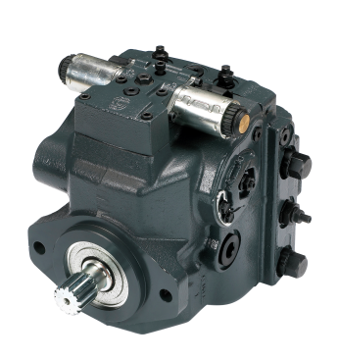
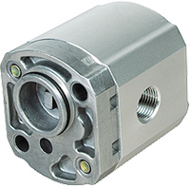
Bill of Materials
(1) Danfoss H1 Closed Loop Hydrostatic (2.32 CID)
(4) Casappa Piggyback gear pumps (.5 & .75 CID
(2) Eaton 2K Drive Motors (8 CID)
(2) Donaldson Duramax Filter Units (2 and 10 micron Nominal)
(1) Kubota V2403-Turbo Diesel Engine ~ 74hp

Slide 4
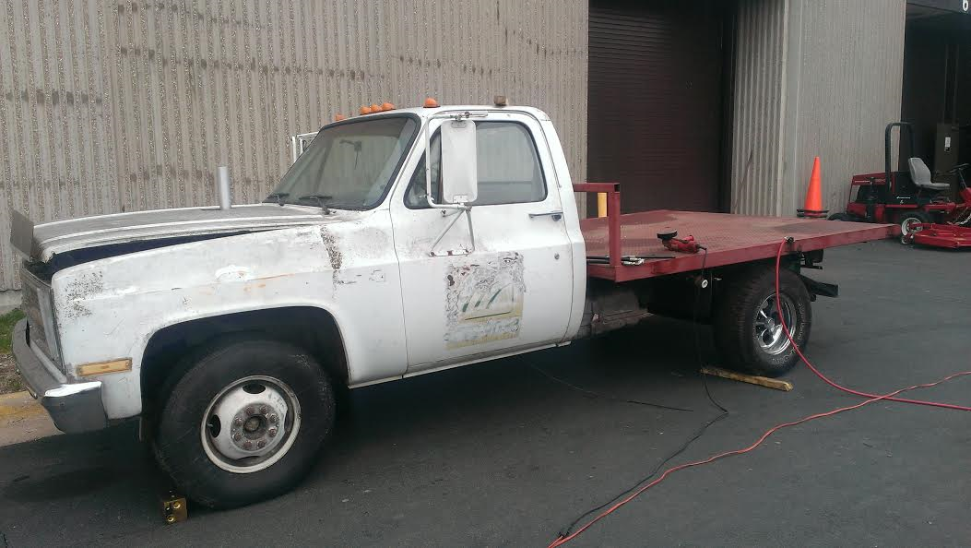
1982 GMC 1 TON FLATBED
Original Engine size = 5.7L 350 Cubic Inch V8 Gas
New Engine = 2.4L 4 Cylinder Kubota Turbo Diesel ~ 74hp

Slide 5
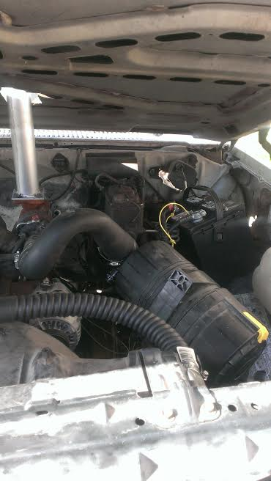
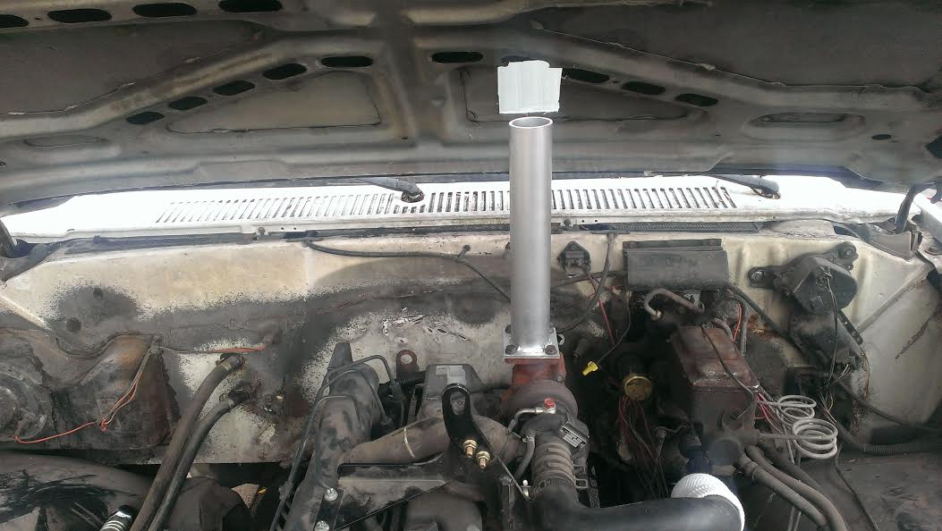
The new engine is in!

Slide 6
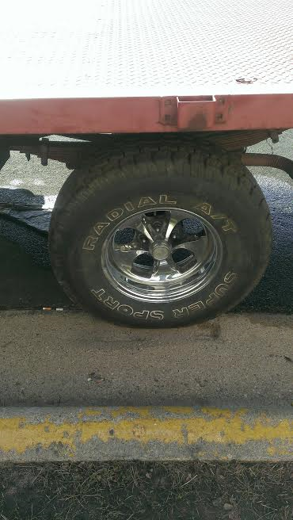
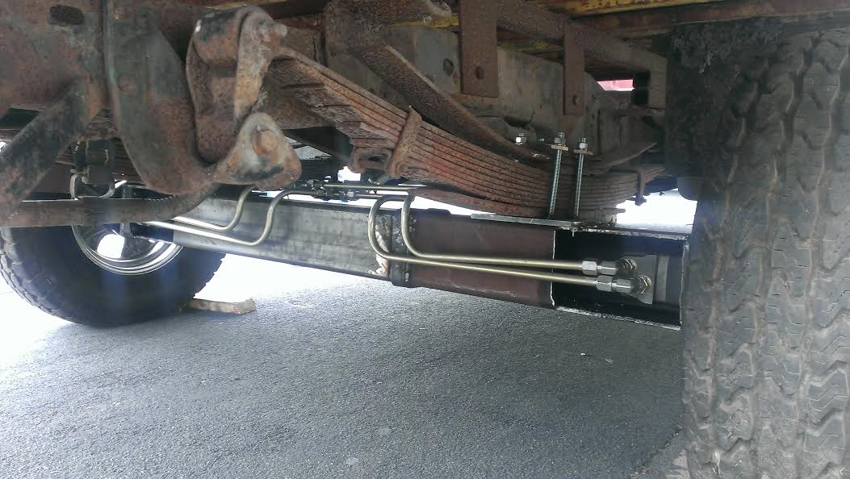
Axles and wheel motors
Eaton 2000

Slide 7
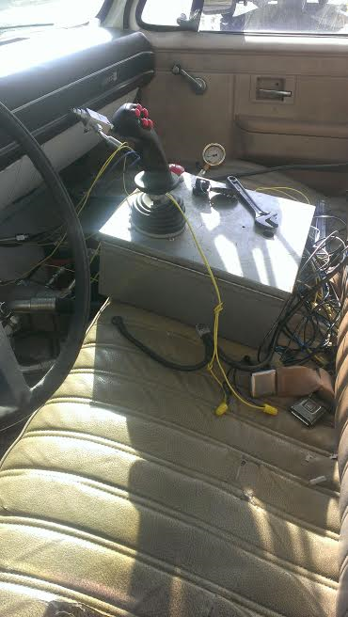
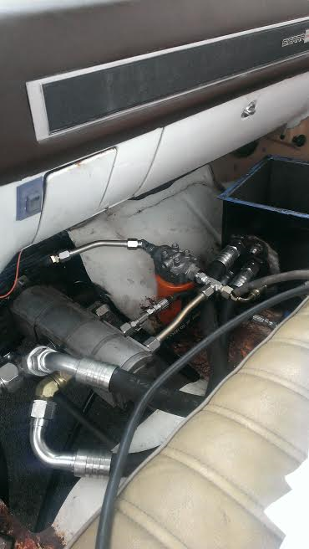
Control box, pump and reservoir

Slide 8
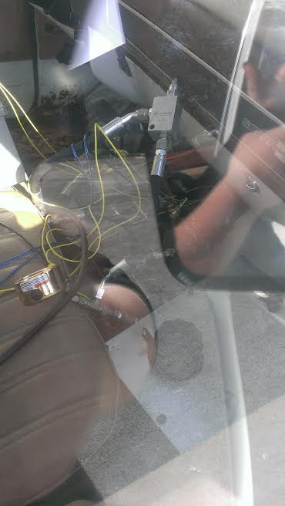
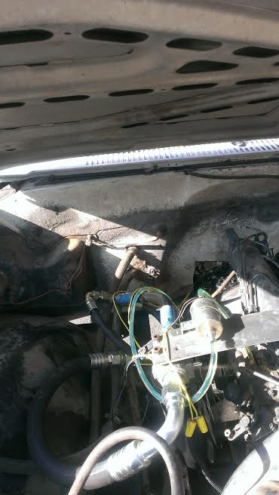
Little bit of pluming going on

Slide 9
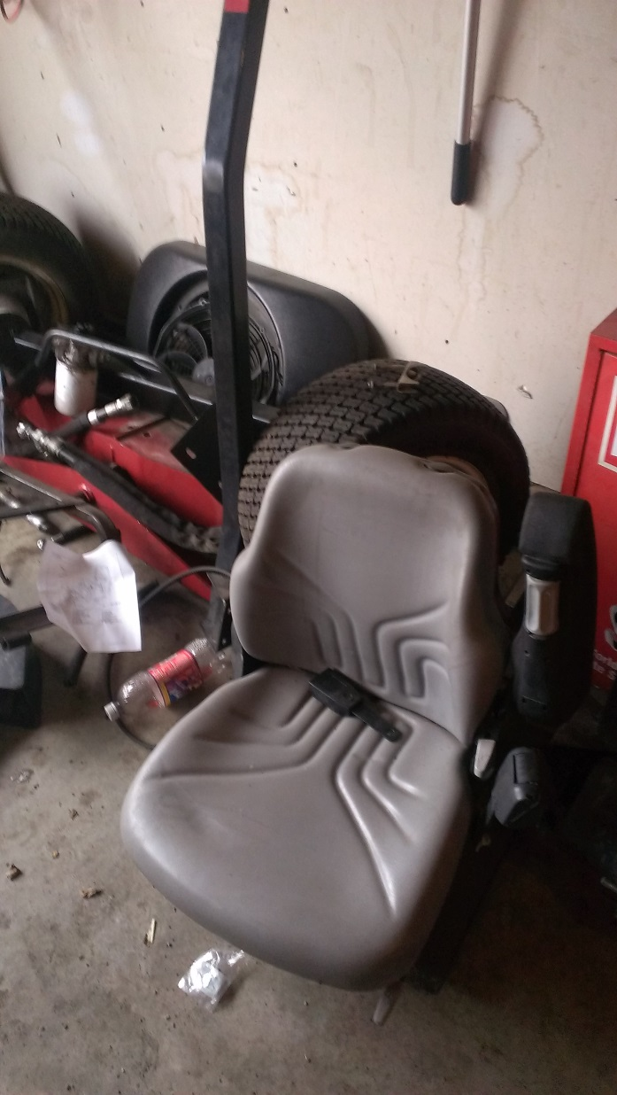
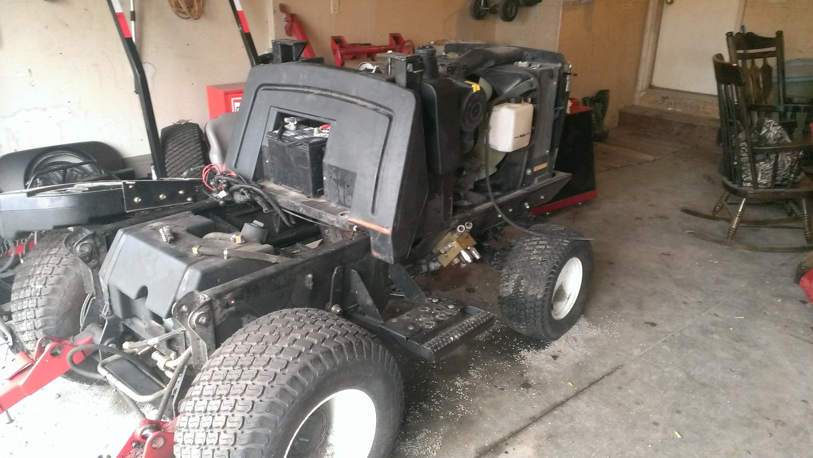
Where the engine came from

Slide 10
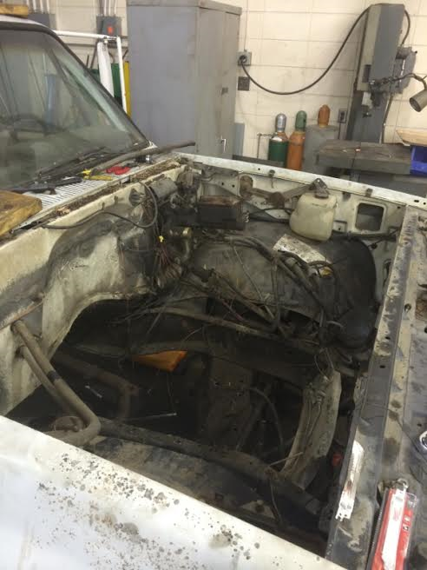
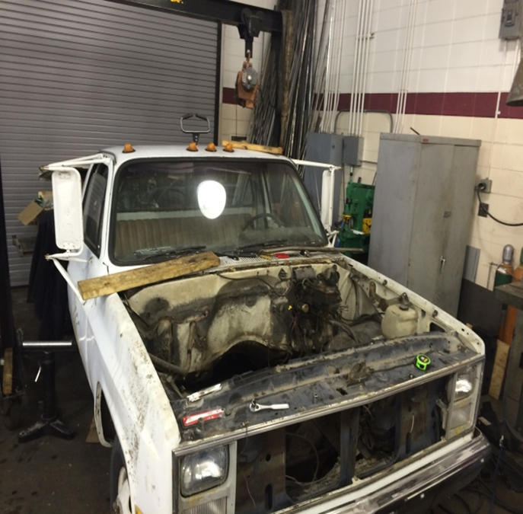
Empty Truck

Slide 11
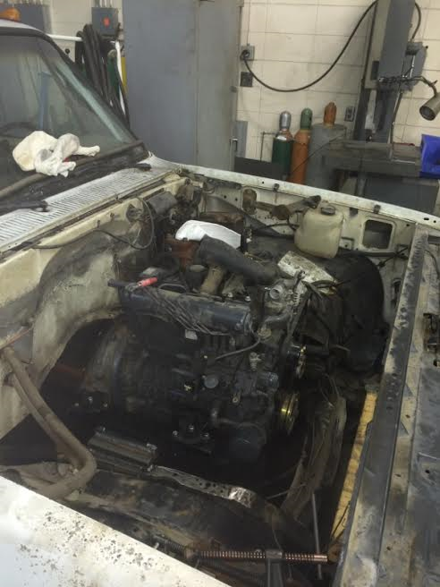
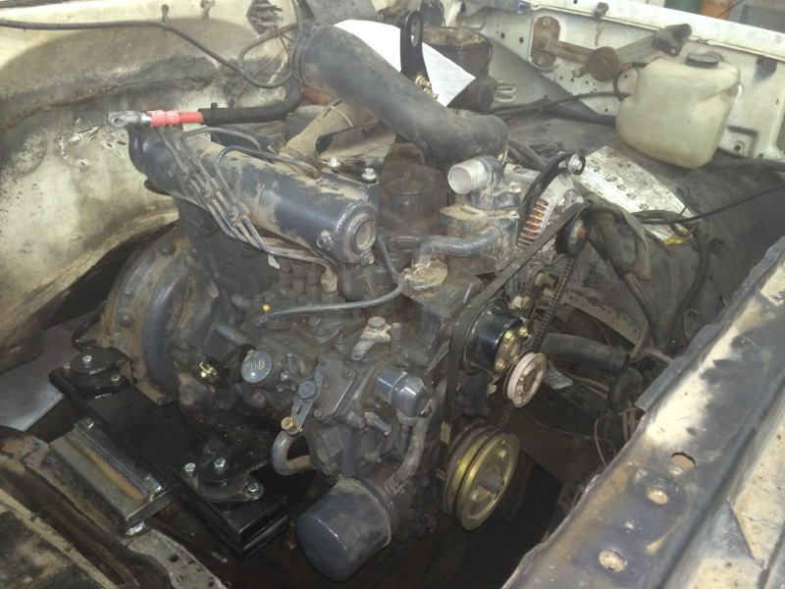
It’s a perfect fit!

